Slide 1

RESEARCH & DEVELOPMENT

Slide 2


CRM PROCESS FLOW

Slide 3
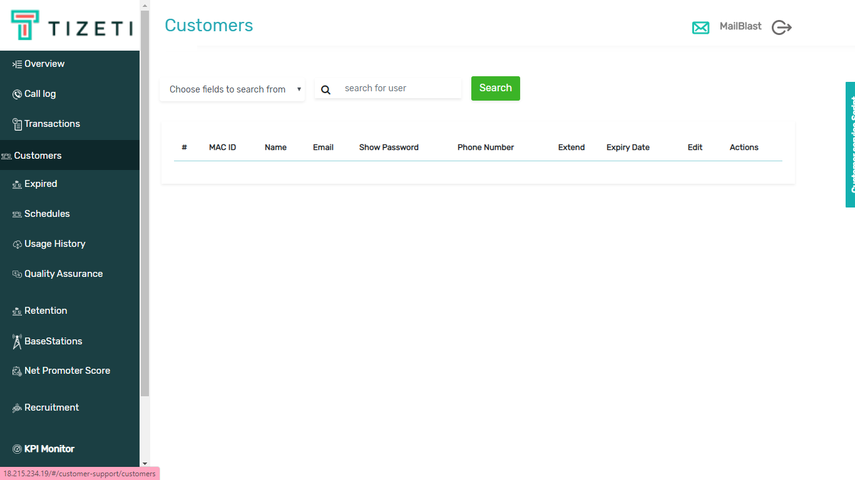
STAFF: CLICKS ON ‘CUSTOMERS’ PAGE

Slide 4
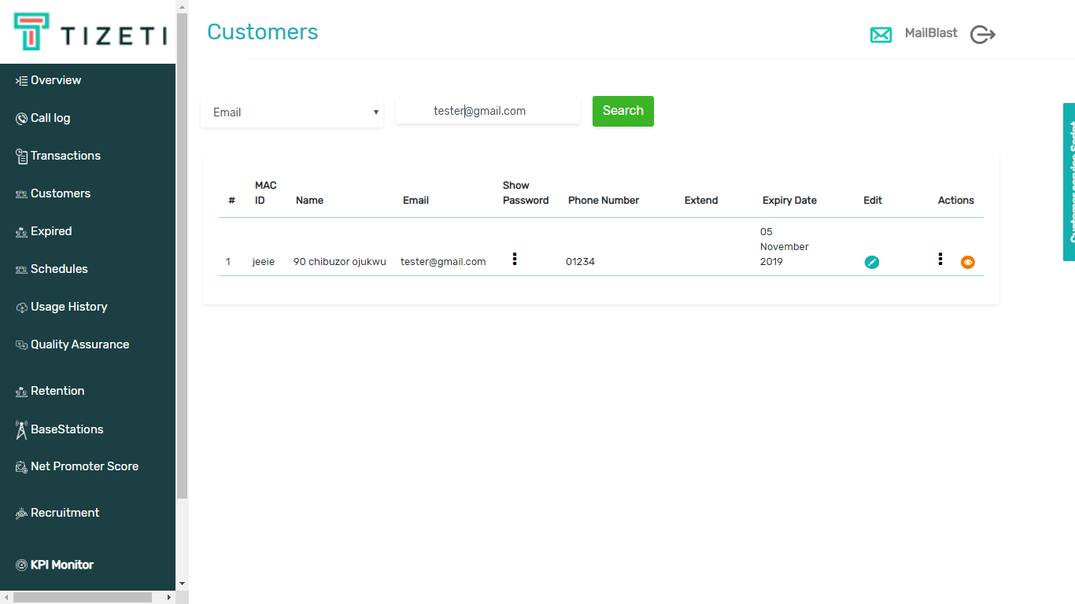
STAFF: SEARCHES FOR CUSTOMER

Slide 5
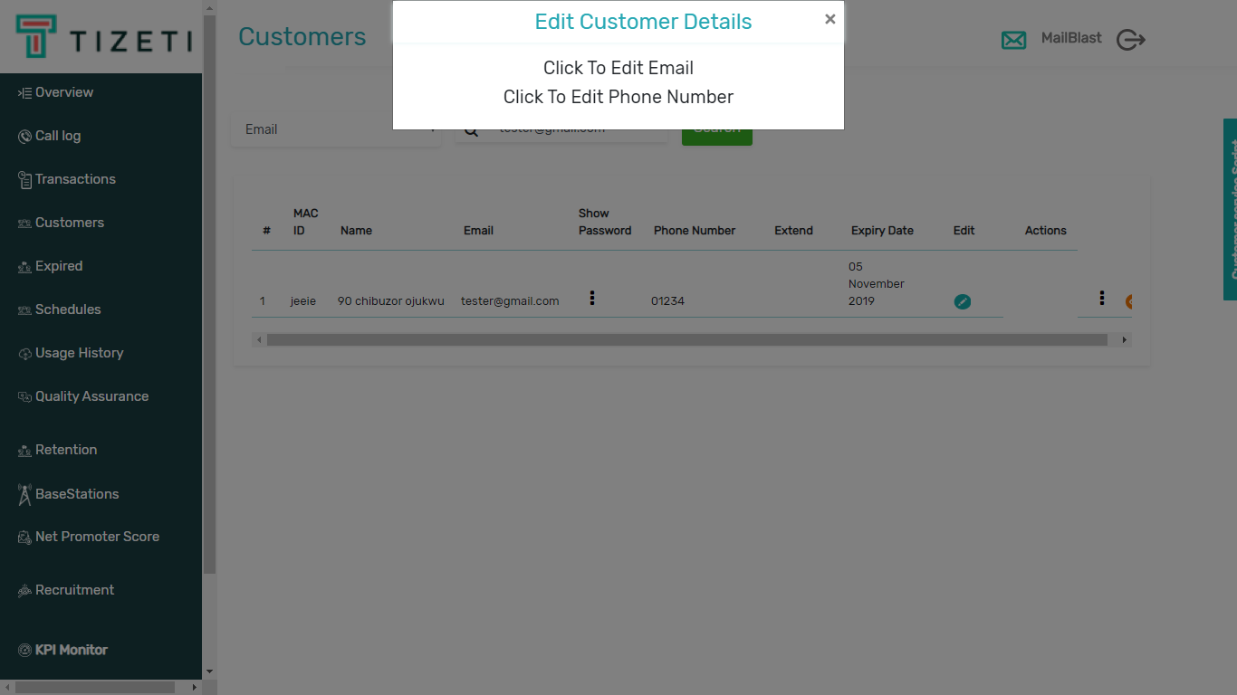
STAFF: CLICKS ON ‘EDIT’ BUTTON AND CAN EDIT EMAIL OR PHONE

Slide 6
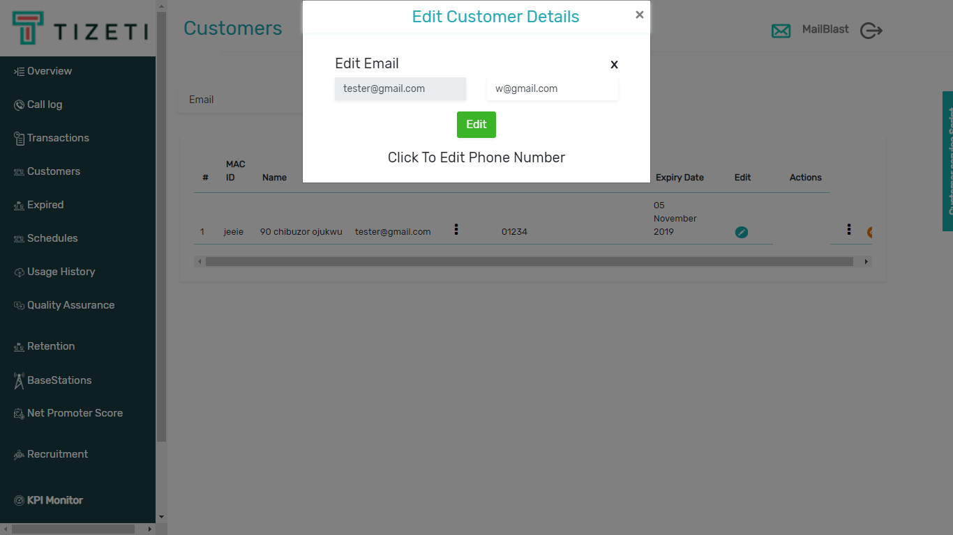
STAFF: CLICKS TO EDIT EMAIL

Slide 7
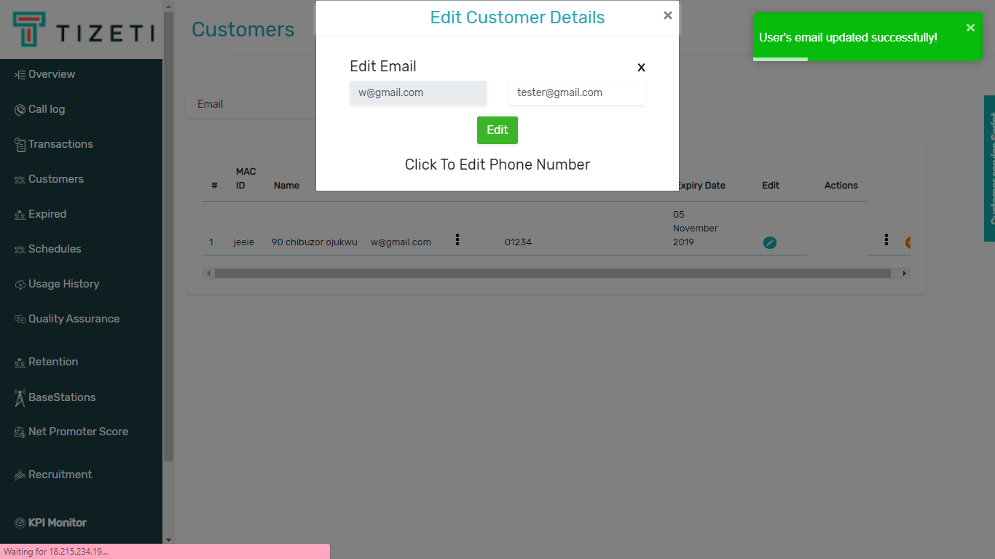
STAFF: SUCCESSFULLY EDITS EMAIL

Slide 8
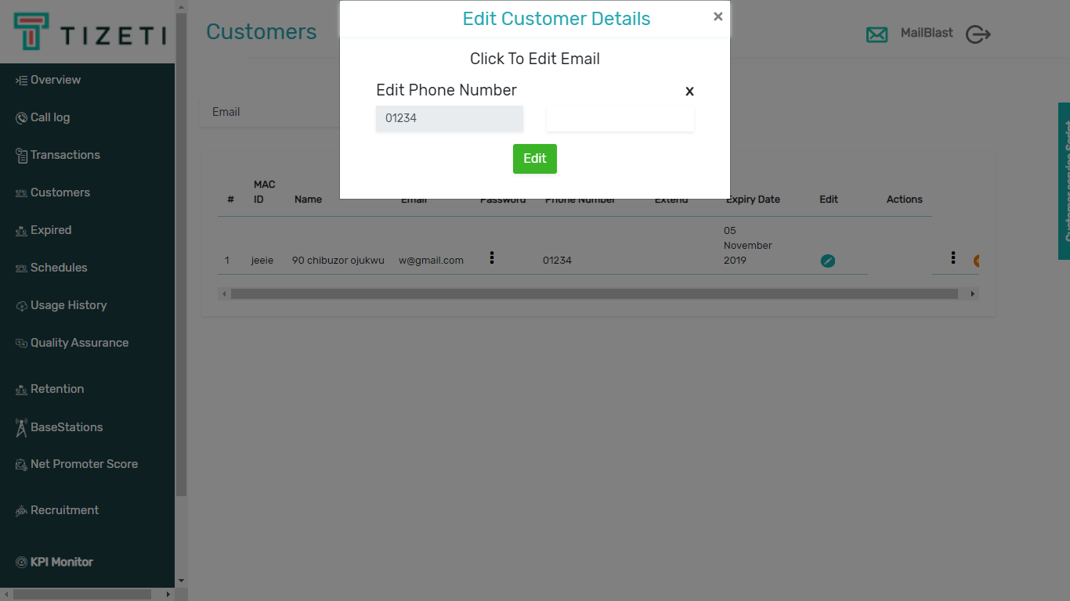
STAFF: CLICKS TO EDIT PHONE

Slide 9
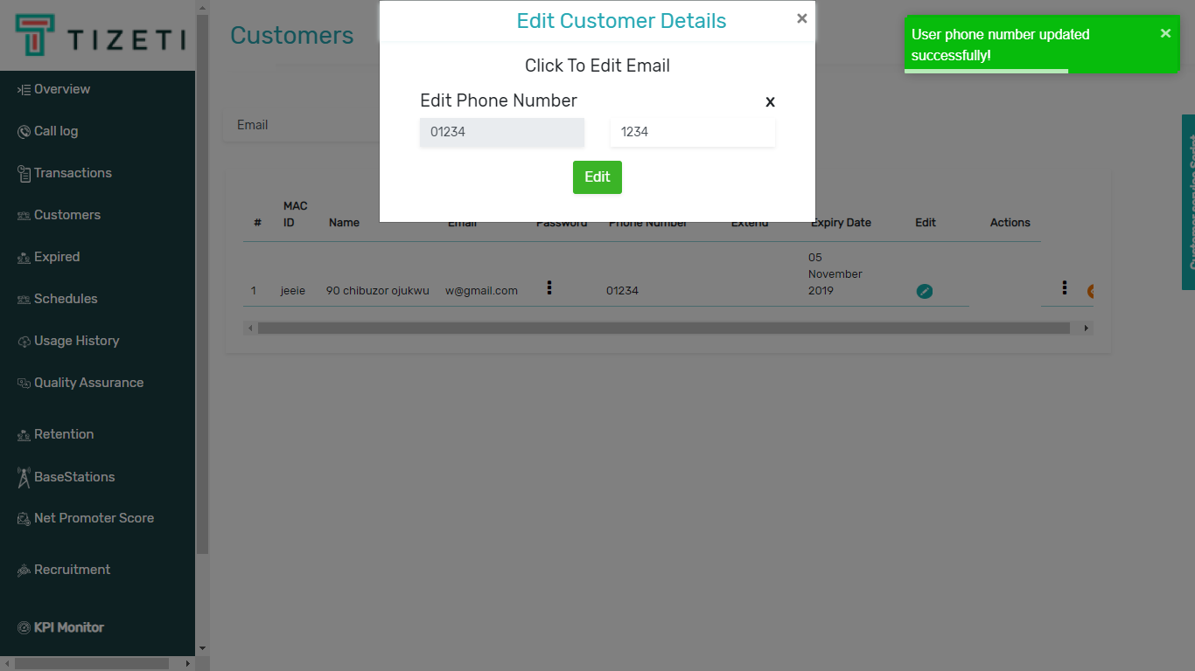
STAFF: SUCCESSFULLY EDITS PHONE

Slide 10
THANKS.

